Slide 1
Alfresco SDK
Past, present and future

Slide 2

Ole Hejlskov
Product Manager, Developer Platform & APIs
ole.hejlskov@alfresco.com
@OleHejlskov

Slide 3
Ole Hejlskov Product Manager ole.hejlskov@alfresco.com @OleHejlskov
About me
Some of you may know me as ohej
Works at Alfresco as Developer Evangelist
Transitioning into product management
I’m responsible for Developer Platform & API’s
6 years of experience working with Alfresco
Co-founder of Order of The Bee
Community contributor
SDK contributions
Aikau tutorials
Almost always online in #Alfresco @FreeNode
Open Source enthusiast

Slide 4
Agenda
About me
The Good, The Bad and The Ugly
The Past, Present and Future
Demo
Questions

Slide 5
The Good

Slide 6
Alfresco SDK has gained traction
Easy to get started
Example code and tests
Hot reloading
SDK 2.0 and 2.1 really improves productivity
More and more fixes in product rather than SDK
Integrates easily with IDEs
Combined with hot reloading it gives the Save’n’refresh feel
Debugging is easier
Easy to get help
If you are facing an issue with your code, having it all in an SDK project it is easy to send the whole project and have get help in the community
This also applies to Developer Support!
A lot of good resources
SDK Video tutorial (a bit old, but still valid)
Revamped documentation
The Good

Slide 7
The Bad

Slide 8
Alfresco SDK was created before Alfresco was fully “mavenized”
This means that a lot of hacks was made in the SDK
H2 support ended in limbo
Solr artifacts changed in 4.2.f, 5.0.c and 5.0.d
Solr SSL / Repo SSL hacks
Replacer plugin to comment out sections in web.xml
Complex compatibility matrix
The Bad

Slide 9
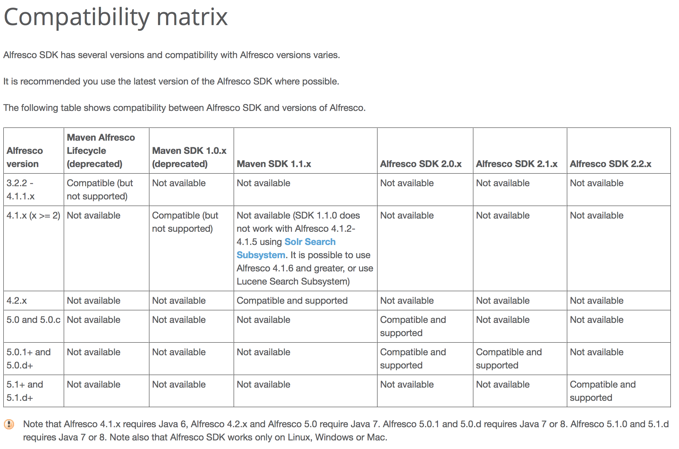
The Bad

Slide 10
Alfresco SDK was created before Alfresco was fully “mavenized”
This means that a lot of hacks was made in the SDK
H2 support ended in limbo
Solr artifacts changed in 4.2.f, 5.0.c and 5.0.d
Solr SSL / Repo SSL hacks
Replacer plugin to comment out sections in web.xml
Complex compatibility matrix
Java 7 vs Java 8
SDK 2.1 was Java8 only
SDK 2.1.1 reverted this so it once again works with Java7
SDK 2.2 is compatible with Java7 and Java8, but 5.1 only works with Java8
SDK 2.2 is only compatible with Alfresco 5.1 and onwards
The Bad

Slide 11
The Ugly

Slide 12
AMPs + Custom directory layout + hot reloading == Messy classpath
alfresco-maven-plugin installs AMP into the WAR
Also copies everything to target/classes + target/test-classes
Same resources present in three locations, which one wins?
Resources are loaded twice (at least)
Will every IDE respect all the <resources/> instructions to make sure files are put in the right place?
YES – but it takes ~150 lines of Maven configuration
Archetype changes between almost every release
Static copy of H2 dialect DB scripts causes incompatibility
Upgrading a SDK project is a major pain
The Ugly

Slide 13
The Past, Present and Future

Slide 14
The Past

Slide 15
Alfresco Maven SDK Founded by Gab and Maurizio
- All-in-one + Repo AMP archetypes
- Limited features
- Mostly focused on building AMPS and running
Code migrated to GitHub
2.0 released
First release on Maven Central
Fully supported by Alfresco
Renamed to “Alfresco SDK”
Hot reloading
Spring loaded for Java hot reloading
Functional and regression testing
Share AMP support
2009
2013
2014
2014
2.1 released
Improved hot reloading
Full documentation revamp
Alfresco Maven SDK 1.1.1
- Remote unit test runner
- JRebel support
- Solr support

Slide 16
The Present

Slide 17
2.2 released
Number of bug fixes
Dedicated H2 artifact (Thanks Samuel!!)
Remove Java8 dependency
However 5.1 is only supported on Java8
ONLY Compatible with 5.1
No spring-loaded
Security issue in spring-loaded causes trouble
2.1.1 not compatible with 5.1
Works if you manually patch with H2 scripts or use an external DB
The Present

Slide 18
Features of the Alfresco SDK 2.2 Today
All-in-one, Repository AMP and Share AMP archetypes
Hot reloading
Java classes (spring loaded)
Static resources (client side Javascript and CSS)
Server side javascript
Spring Beans
Can be added by using JRebel, but we have seen a number of issues regarding behaviours being loaded multiple times
Dynamic “refresh web scripts” when compiling/process-resources
IDE Integration
Eclipse and IntelliJ IDEA works mostly out of the box
The Present

Slide 19
2.1.1 is not compatible with 5.1.x
2.2 is only compatible with 5.1 but not 5.0
5.1 introduced a new table for authorization
The SDK contains a copy of the PostgreSQL DB scripts that H2 uses
The H2 scripts are now out dated
This issue also affects 4.2.5 and SDK 1.1.1 projects
The solution was to create an H2 artifact that is released along with the repository – including community edition
We now have this from 5.0.d and onwards
SDK 2.1.1 can be modified to work with 5.1
Working example can be found here
The Present

Slide 20
The Future

Slide 21
Let’s step back for a minute..

Slide 22
What is the problem we are trying to solve?

Slide 23
“As a developer I need simple, agile, and future-proof tools to extend Alfresco so that I can meet the needs of my evolving business”
I expect to achieve this with
Modern, Industry-Standard Conventions and Tooling, Comprehensive and Reliable Public APIs and Supported Extension Mechanisms
That Work Across Versions of the Product

Slide 24
Requirements
Lifecycle management
Tooling
Hot reloading
Seamless integration with IDEs
Based on standards and conventions
Small footprint on projects
Easy to upgrade
Compatibility across versions
Users should not have to be a Maven expert to get the SDK running

Slide 25
It all starts with a JAR

Slide 26
AMP vs JAR
The Future
Feature | AMP | JAR
3rd party dependencies | Yes | No
Control module load order | Yes | No
Isolated and separated class path | No | Yes
Transient dependency management | No | Yes
Works for both repo and share | Yes | Yes
Invasive/Complex Maven setup | Yes | No
Seamless integration with IDEs | No | Yes
Easy to create cross project dependencies | No | Yes

Slide 27
JAR Support in 5.1
JAR Support in 5.1
${ALF_HOME}/modules/[platform|share]
Simple module, no 3rd party dependencies
Include module.properties
Put static assets in META-INF/resources
Servlet3 specs takes care of this
Put web fragments in META-INF/web-fragment.xml
Allows additive changes to web.xml
Look at Alfresco SDK Samples in GitHub for references
5.1 still support AMPs – no change
Install with MMT as usual
Supports 3rd party dependencies
The Future

Slide 28
JAR Support in 5.1
JAR Support in 5.1
${ALF_HOME}/modules/[platform|share]
Simple module, no 3rd party dependencies
Include module.properties
Put static assets in META-INF/resources
Servlet3 specs takes care of this
Put web fragments in META-INF/web-fragment.xml
Allows additive changes to web.xml
Look at Alfresco SDK Samples in GitHub for references
5.1 still support AMPs – no change
Install with MMT as usual
Supports 3rd party dependencies
The Future
Neither AMPs or JARs are module systems!

Slide 29
Why not just go OSGi?
OGSi would be a major effort and investment
Some efforts has been tried in a community project
Extremely invasive
Not all our dependencies are available
The foundation for OSGi is a JAR
The Future

Slide 30
.. But Java 9 has this new cool thing
It sure does, and we’re following it closely… but it is simply not there yet
The Future

Slide 31
Alfresco SDK 3.0 is under development
JAR Support is a key feature
Makes IDE integration effortless – “it’s a JAR, it just works”
Standard directory layout – no more src/main/amp/*
AMP as an optional assembly
Consolidate “runner” logic into a plugin
mvn alfresco:run
Can run repo, solr and share – or each individually
Optional parent pom
Testing (Unit, integration and functional testing)
Hot reloading
Integration with Alfresco SPK
Yeoman generator – Thanks Bindu!!!!!
The Future

Slide 32
Demo

Slide 33
JARs are just the first step
We are actively investigating a new module/plugin system for Alfresco
OSGi does not seem to be the answer, but it has not been fully ruled out
By reverting to a JAR with AMPs as an optional assembly it becomes easy to support a new format while still ensuring backwards compatibility
We do not currently have a timeline for the new module system
The Future

Slide 34
Questions?

Slide 35
Thanks!
</presentation>

